Slide 1



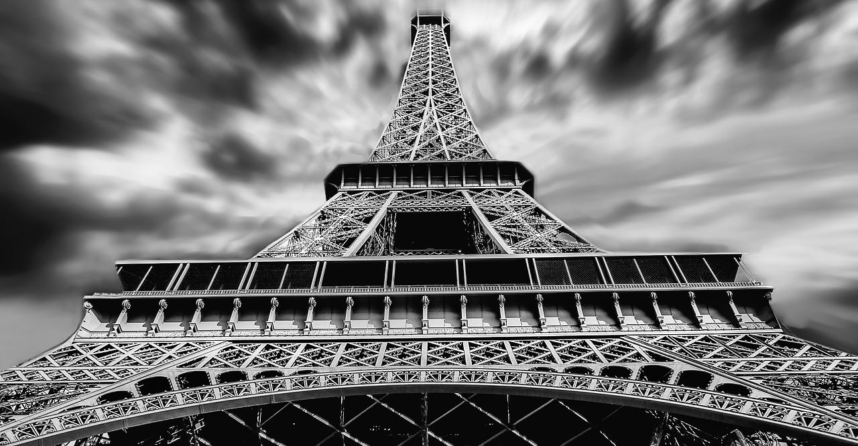

杂志风公司简介
The user can demonstrate on a projector or computer, or print the presentation and make it into a film to be used in a wider field. Using PowerPoint,
2018

Slide 2

01. 公司团队介绍
CONTENT
The user can demonstrate on a projector
02. 产品服务推广
The user can demonstrate on a projector
03. 企业文化荣誉
The user can demonstrate on a projector
04. 企业发展规划
The user can demonstrate on a projector

Slide 3

01
公司团队介绍
The user can demonstrate on a projector or computer, or print the presentation and make it into a film to be used in a wider field. Using PowerPoint,

Slide 4
公司团队介绍
标题文字添加
标题文字添加
标题文字添加
标题文字添加
The user can demonstrate on a projector or computer, or print the presentation and make it into a film to be used in a wider field. Using PowerPoint,
The user can demonstrate on a projector or computer, or print the presentation and make it into a film to be used in a wider field. Using PowerPoint,
The user can demonstrate on a projector or computer, or print the presentation and make it into a film to be used in a wider field. Using PowerPoint,
The user can demonstrate on a projector or computer, or print the presentation and make it into a film to be used in a wider field. Using PowerPoint,

Slide 5


公司团队介绍
标题文字添加
标题文字添加
The user can demonstrate on a projector or computer, or print the presentation and make it into a film to be used in a wider field. Using PowerPoint,
The user can demonstrate on a projector or computer, or print the presentation and make it into a film to be used in a wider field. Using PowerPoint,
标题文字添加
标题文字添加
The user can demonstrate on a projector or computer, or print the presentation and make it into a film to be used in a wider field. Using PowerPoint,
The user can demonstrate on a projector or computer, or print the presentation and make it into a film to be used in a wider field. Using PowerPoint,

Slide 6
公司团队介绍
标题文字添加
The user can demonstrate on a projector or computer, or print the presentation and make it into a film to be used in a wider field. Using PowerPoint,
标题文字添加
The user can demonstrate on a projector or computer, or print the presentation and make it into a film to be used in a wider field. Using PowerPoint,
标题文字添加
标题文字添加
The user can demonstrate on a projector or computer, or print the presentation and make it into a film to be used in a wider field. Using PowerPoint,
The user can demonstrate on a projector or computer, or print the presentation and make it into a film to be used in a wider field. Using PowerPoint,

Slide 7
公司团队介绍
50%
30%
10%
20%
15%
25%
20%
16%
标题文字添加
标题文字添加
标题文字添加
标题文字添加
The user can demonstrate on a projector or computer, or print the presentation and make it into a film to be used in a wider field. Using PowerPoint,
The user can demonstrate on a projector or computer, or print the presentation and make it into a film to be used in a wider field. Using PowerPoint,
The user can demonstrate on a projector or computer, or print the presentation and make it into a film to be used in a wider field. Using PowerPoint,
The user can demonstrate on a projector or computer, or print the presentation and make it into a film to be used in a wider field. Using PowerPoint,

Slide 8
公司团队介绍
标题文字
添加
The user can demonstrate on a projector or computer, or print the presentation and make it into a film to be used in a wider field. Using PowerPoint, The user can demonstrate on a projector or computer, or print the presentation and make it into a film to be used in a wider field. Using PowerPoint,
标题文字
添加
The user can demonstrate on a projector or computer, or print the presentation and make it into a film to be used in a wider field. Using PowerPoint, The user can demonstrate on a projector or computer, or print the presentation and make it into a film to be used in a wider field. Using PowerPoint,
The user can demonstrate on a projector or computer, or print the presentation and make it into a film to be used in a wider field. Using PowerPoint, The user can demonstrate on a projector or computer, or print the presentation and make it into a film to be used in a wider field. Using PowerPoint,
标题文字
添加

Slide 9
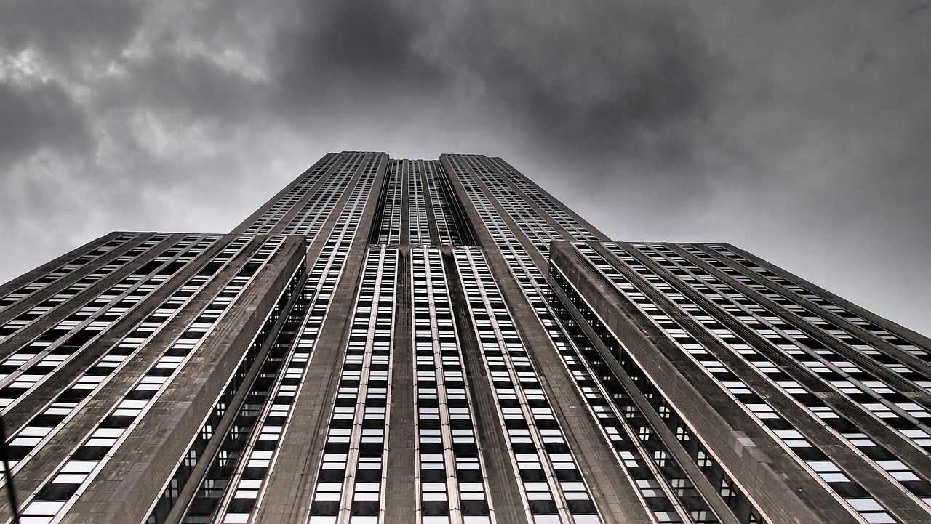
02
产品服务推广
The user can demonstrate on a projector or computer, or print the presentation and make it into a film to be used in a wider field. Using PowerPoint,

Slide 10
产品服务推广
标题文字添加
The user can demonstrate on a projector or computer, or print the presentation and make it into a film to be used in a wider field. Using PowerPoint,
The user can demonstrate on a projector or computer, or print the presentation and make it into a film to be used in a wider field. Using PowerPoint,
The user can demonstrate on a projector or computer, or print the presentation and make it into a film to be used in a wider field. Using PowerPoint,
关键词
70%
关键词
45%
关键词
95%
关键词
60%

Slide 11
产品服务推广
标题文字添加
The user can demonstrate on a projector or computer, or print the presentation and make it into a film to be used in a wider
标题文字添加
The user can demonstrate on a projector or computer, or print the presentation and make it into a film to be used in a wider
标题文字添加
The user can demonstrate on a projector or computer, or print the presentation and make it into a film to be used in a wider
标题文字添加
The user can demonstrate on a projector or computer, or print the presentation and make it into a film to be used in a wider

Slide 12
产品服务推广
标题文字添加
标题文字添加
The user can demonstrate on a projector or computer, or print the presentation and make it into a film to be used in a wider field. Using PowerPoint,
01
02
The user can demonstrate on a projector or computer, or print the presentation and make it into a film to be used in a wider field. Using PowerPoint,
03
04
标题文字添加
标题文字添加
The user can demonstrate on a projector or computer, or print the presentation and make it into a film to be used in a wider field. Using PowerPoint,
The user can demonstrate on a projector or computer, or print the presentation and make it into a film to be used in a wider field. Using PowerPoint,

Slide 13
产品服务推广
The user can demonstrate on a projector or computer, or print the presentation and make it into a film to be used in a wider field. Using PowerPoint,
The user can demonstrate on a projector or computer, or print the presentation and make it into a film to be used in a wider field. Using PowerPoint,
标题文字添加
标题文字添加
The user can demonstrate on a projector or computer, or print the presentation and make it into a film to be used in a wider field
标题文字添加
标题文字添加
标题文字添加
The user can demonstrate on a projector or computer, or print the presentation and make it into a film to be used in a wider field
The user can demonstrate on a projector or computer, or print the presentation and make it into a film to be used in a wider field. Using PowerPoint,
标题文字添加
标题文字添加
The user can demonstrate on a projector or computer, or print the presentation and make it into a film to be used in a wider field. Using PowerPoint,

Slide 14


产品服务推广
标题文字添加
标题文字添加
标题文字添加
The user can demonstrate on a projector or computer, or print the presentation and make it into a film to be used in a wider field. Using PowerPoint,
The user can demonstrate on a projector or computer, or print the presentation and make it into a film to be used in a wider field. Using PowerPoint,
The user can demonstrate on a projector or computer, or print the presentation and make it into a film to be used in a wider field. Using PowerPoint,

Slide 15

03
企业文化荣誉
The user can demonstrate on a projector or computer, or print the presentation and make it into a film to be used in a wider field. Using PowerPoint,

Slide 16
企业文化荣誉
标题文字添加
标题文字添加
The user can demonstrate on a projector or computer, or print the presentation and make it into a film to be used in a wider field. Using PowerPoint,
The user can demonstrate on a projector or computer, or print the presentation and make it into a film to be used in a wider field. Using PowerPoint,
标题文字添加
标题文字添加
The user can demonstrate on a projector or computer, or print the presentation and make it into a film to be used in a wider field. Using PowerPoint,
The user can demonstrate on a projector or computer, or print the presentation and make it into a film to be used in a wider field. Using PowerPoint,

Slide 17
企业文化荣誉
1
标题文字添加
2
The user can demonstrate on a projector or computer, or print the presentation and make it into a film to be used in a wider field
3
4
标题文字添加
The user can demonstrate on a projector or computer, or print the presentation and make it into a film to be used in a wider field
标题文字添加
The user can demonstrate on a projector or computer, or print the presentation and make it into a film to be used in a wider field
标题文字添加
The user can demonstrate on a projector or computer, or print the presentation and make it into a film to be used in a wider field

Slide 18


企业文化荣誉
标题文字添加
标题文字添加
标题文字添加
The user can demonstrate on a projector or computer, or print the presentation and make it into a film to be used in a wider field. Using PowerPoint,
The user can demonstrate on a projector or computer, or print the presentation and make it into a film to be used in a wider field. Using PowerPoint,
The user can demonstrate on a projector or computer, or print the presentation and make it into a film to be used in a wider field. Using PowerPoint,

Slide 19


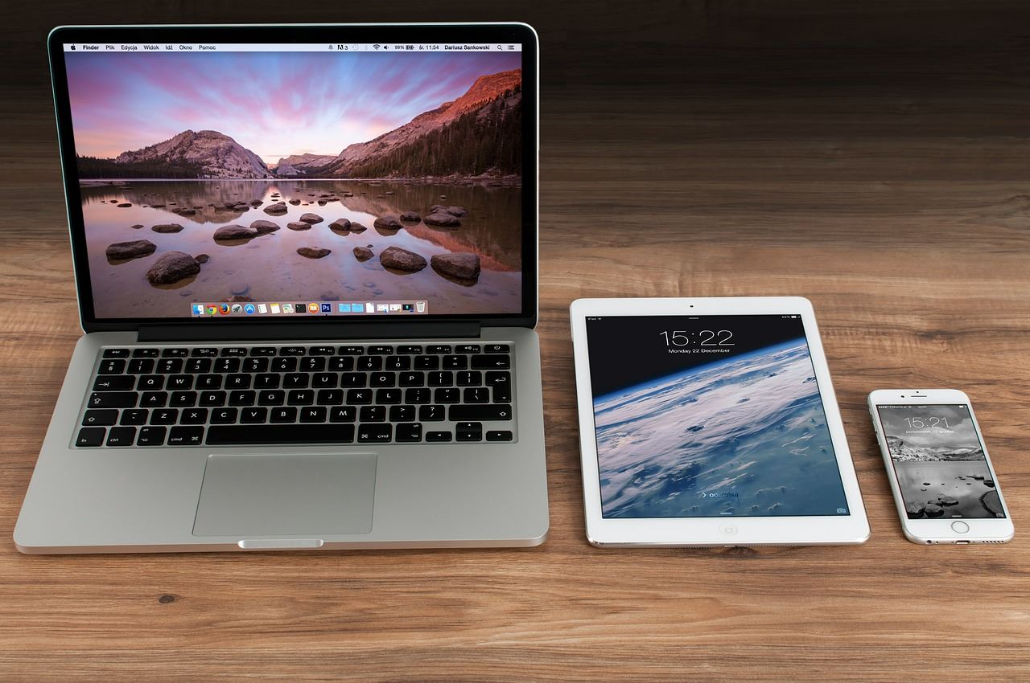
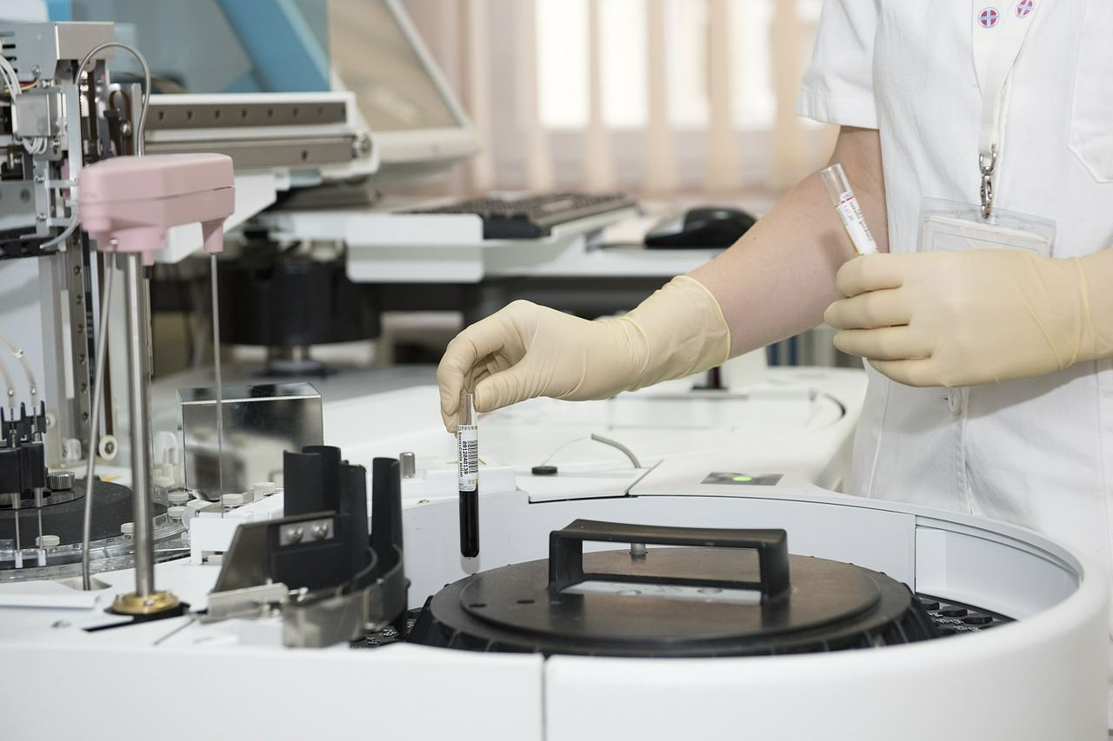


企业文化荣誉
标题文字添加
标题文字添加
标题文字添加
标题文字添加
The user can demonstrate on a projector or computer
The user can demonstrate on a projector or computer
The user can demonstrate on a projector or computer
The user can demonstrate on a projector or computer
标题文字添加
标题文字添加
标题文字添加
标题文字添加
The user can demonstrate on a projector or computer
The user can demonstrate on a projector or computer
The user can demonstrate on a projector or computer
The user can demonstrate on a projector or computer

Slide 20

04
企业发展规划
The user can demonstrate on a projector or computer, or print the presentation and make it into a film to be used in a wider field. Using PowerPoint,

Slide 21
企业发展规划
key words
key words
标题文字添加
The user can demonstrate on a projector or computer, or print the presentation and make it into a film to be used in a wider field. Using PowerPoint, The user can demonstrate on a projector or computer, or print the presentation and make it into a film to be used in a wider field. Using PowerPoint, The user can demonstrate on a projector or computer, or print the presentation and make it into a film to be used in a wider field. Using PowerPoint,
key words
key words
标题文字添加
标题文字添加
2018
The user can demonstrate on a projector or computer, or print the presentation and make it into a film to be used in a wider field. Using PowerPoint,
The user can demonstrate on a projector or computer, or print the presentation and make it into a film to be used in a wider field. Using PowerPoint,
REPORT

Slide 22




企业发展规划
标题文字添加
标题文字添加
The user can demonstrate on a projector or computer, or print the presentation and make it into a film to be used in a wider field. Using PowerPoint,
The user can demonstrate on a projector or computer, or print the presentation and make it into a film to be used in a wider field. Using PowerPoint,
标题文字添加
标题文字添加
The user can demonstrate on a projector or computer, or print the presentation and make it into a film to be used in a wider field. Using PowerPoint,
The user can demonstrate on a projector or computer, or print the presentation and make it into a film to be used in a wider field. Using PowerPoint,

Slide 23
企业发展规划
80%
77%
76%
70%
62%
50%
36%
文字添加
文字添加
文字添加
文字添加
文字添加
文字添加
文字添加
The user can demonstrate on a projector or computer, or print the presentation and make it into a film to be used in a wider field. Using PowerPoint, The user can demonstrate on a projector or computer, or print the presentation and make it into a film to be used in a wider field. Using PowerPoint, The user can demonstrate on a projector or computer, or print the presentation and make it into a film to be used in a wider field. Using PowerPoint, The user can demonstrate on a projector or computer, or print the presentation

Slide 24



企业发展规划
标题文字添加
标题文字添加
The user can demonstrate on a projector or computer, or print the presentation and make it into a film to be used in a wider field. Using PowerPoint,
The user can demonstrate on a projector or computer, or print the presentation and make it into a film to be used in a wider field. Using PowerPoint,
标题文字添加
标题文字添加
The user can demonstrate on a projector or computer, or print the presentation and make it into a film to be used in a wider field. Using PowerPoint,
The user can demonstrate on a projector or computer, or print the presentation and make it into a film to be used in a wider field. Using PowerPoint,

Slide 25
感谢您的观看
The user can demonstrate on a projector or computer, or print the presentation and make it into a film to be used in a wider field. Using PowerPoint,
2018

