Slide 1

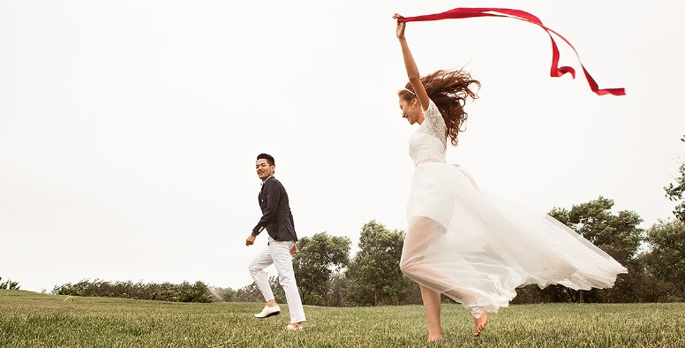
只属于你我的浪漫
Belongs only to you my romance
朱幸福&李甜蜜

Slide 2

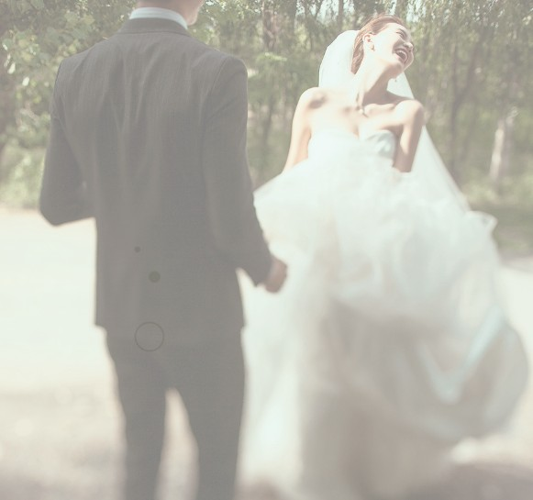
只属于你我的浪漫
Belongs only to you my romance

Slide 3


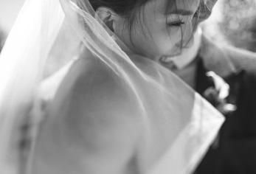
只属于你我的浪漫
Belongs only to you my romance
LOVE

Slide 4
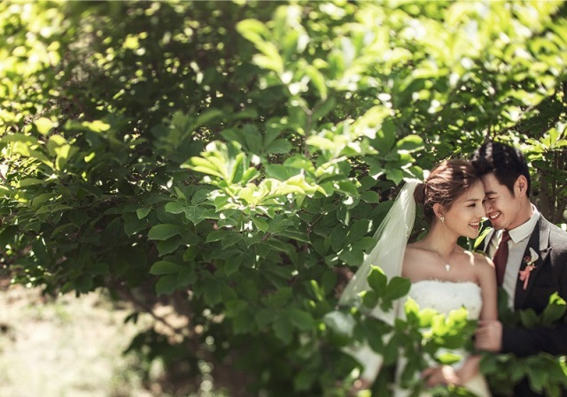
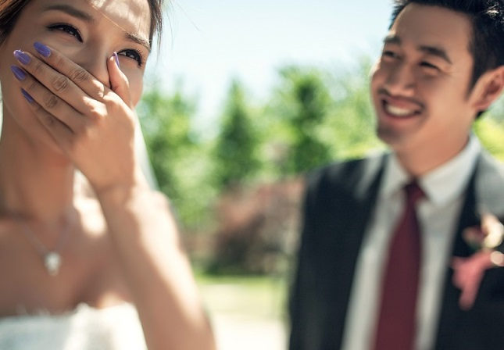
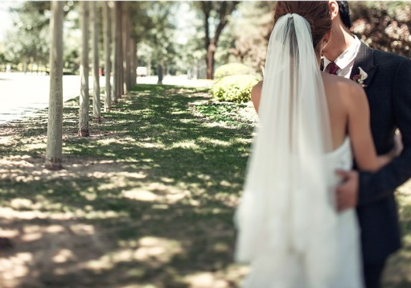

只属于你我的浪漫
Belongs only to you my romance

Slide 5

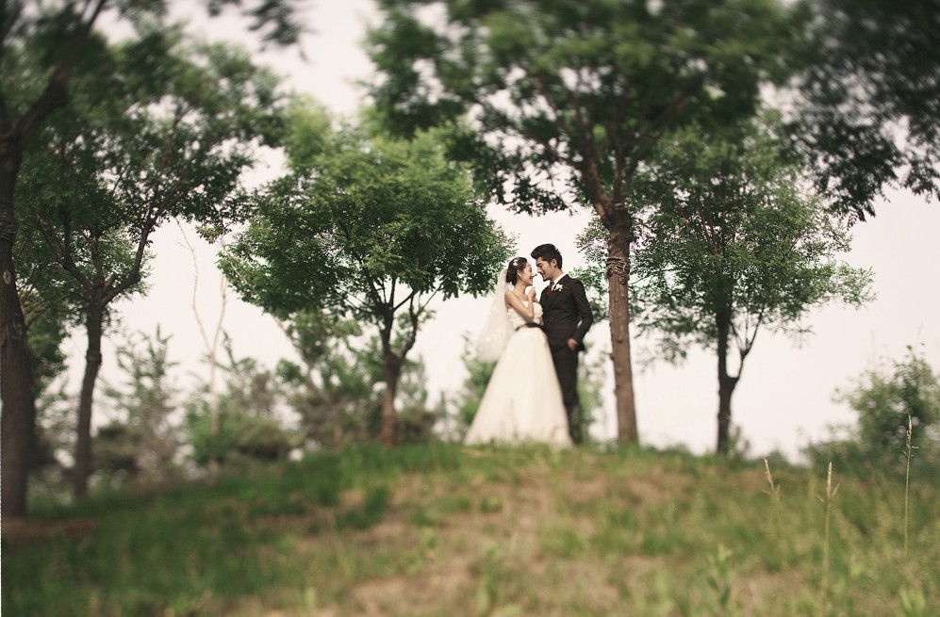
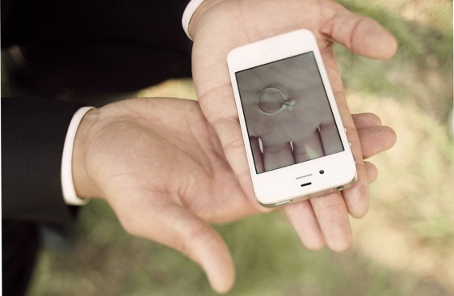
只属于你我的浪漫
Belongs only to you my romance

Slide 6
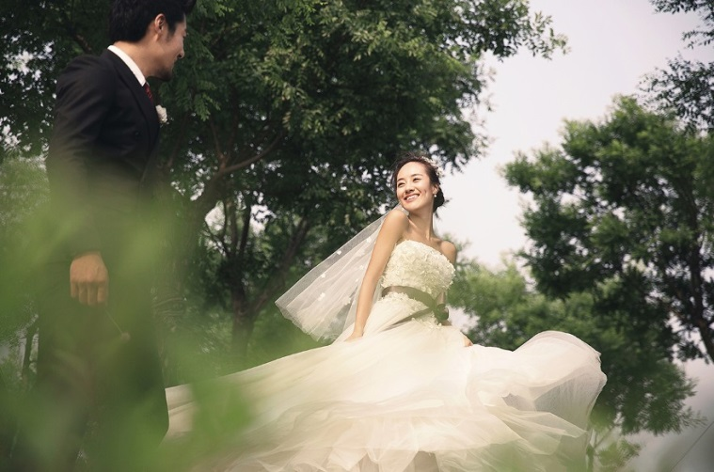
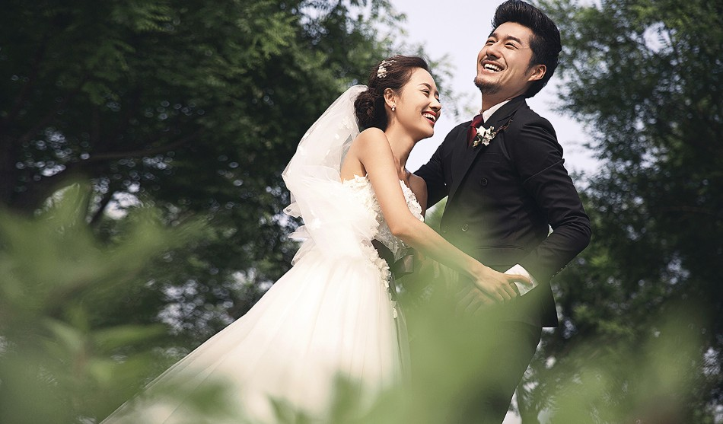
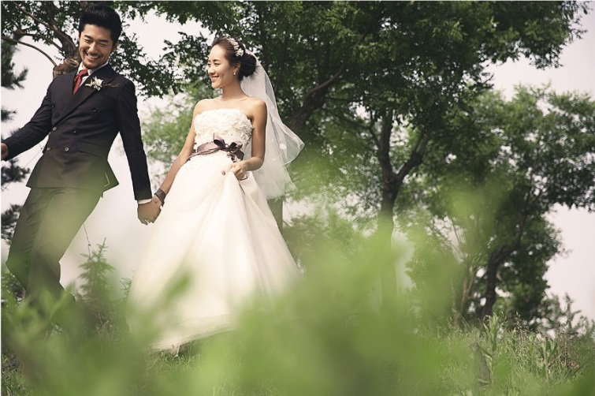
只属于你我的浪漫
Belongs only to you my romance

Slide 7
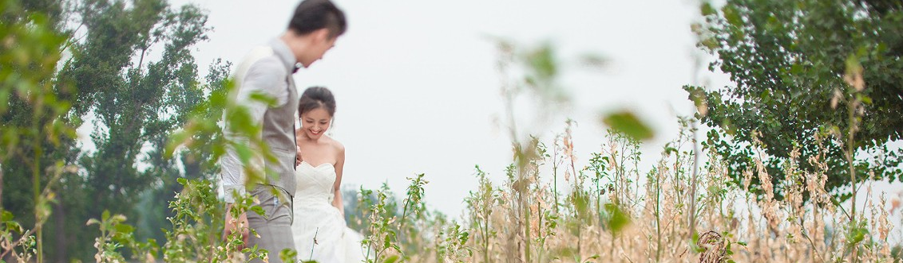
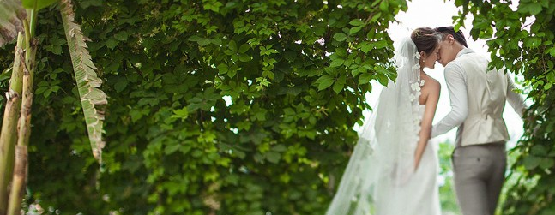
只属于你我的浪漫
Belongs only to you my romance

Slide 8
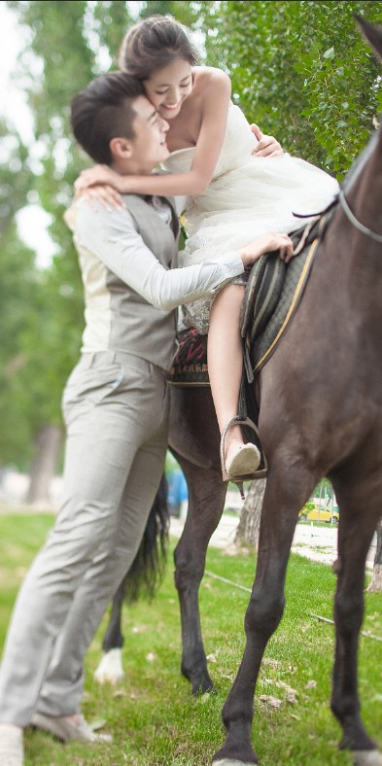
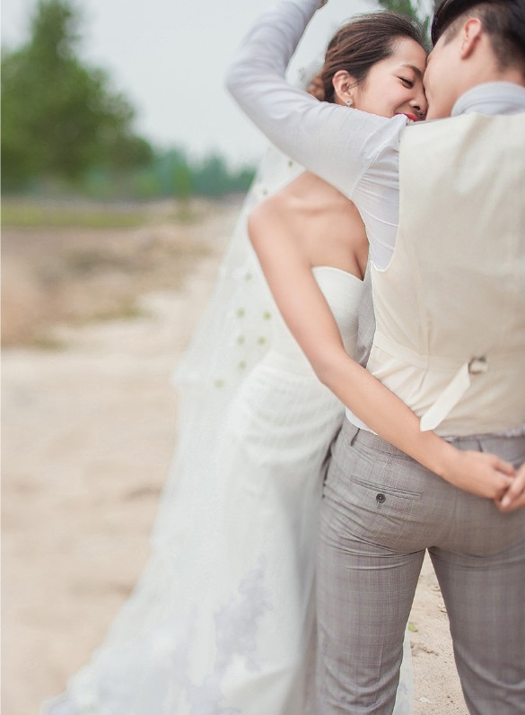
Belongs only to you my romance
只属于你我的浪漫

Slide 9
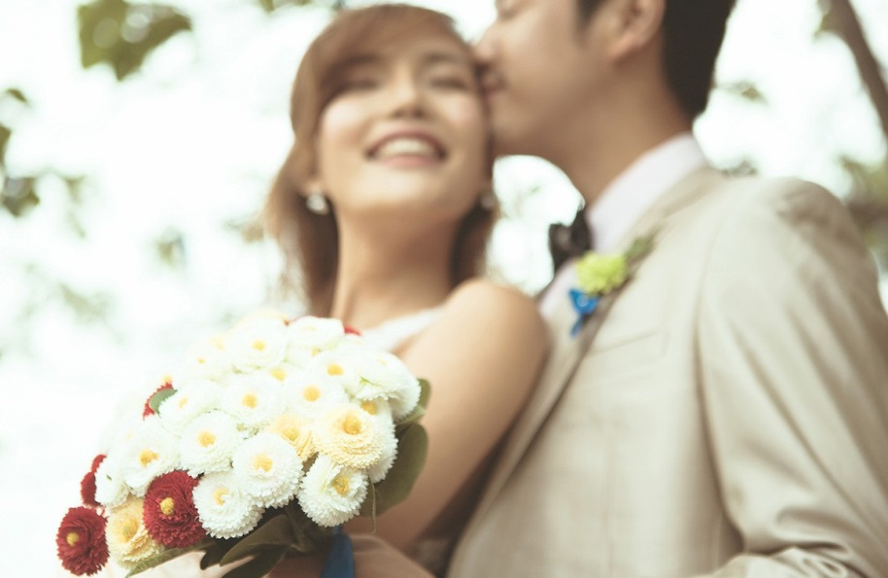
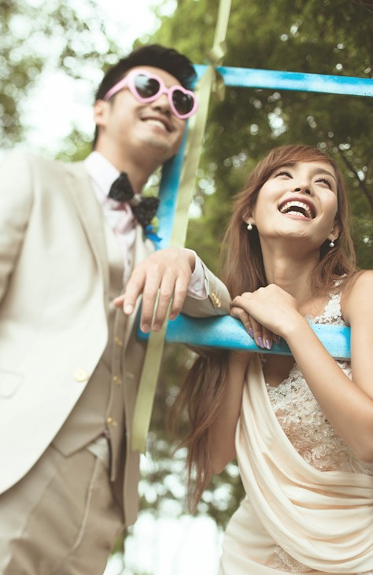
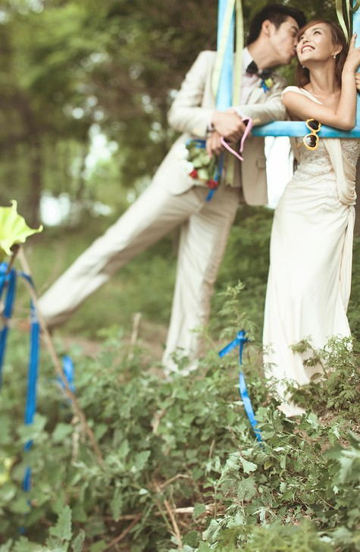

只属于你我的浪漫
Belongs only to you my romance

Slide 10

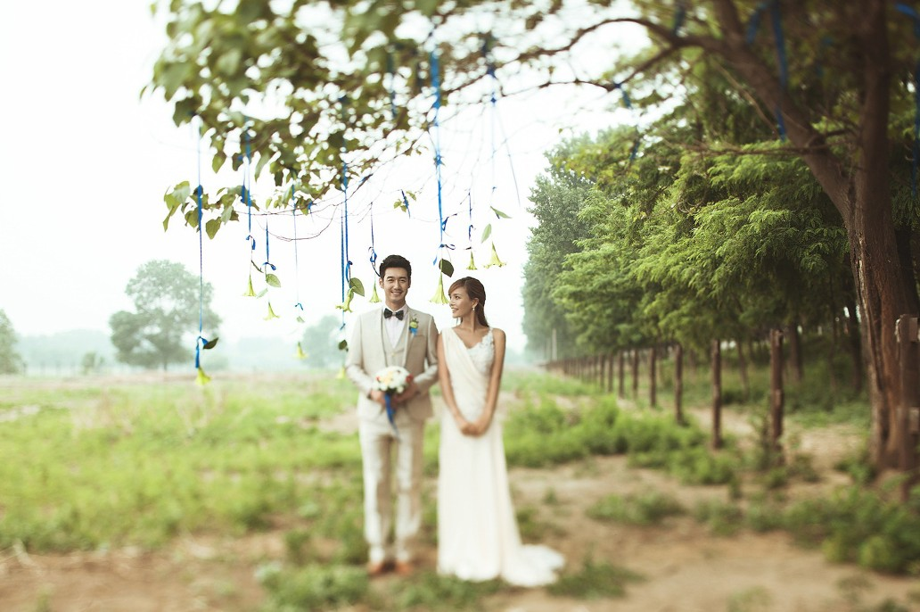
只属于你我的浪漫
Belongs only to you my romance

Slide 11
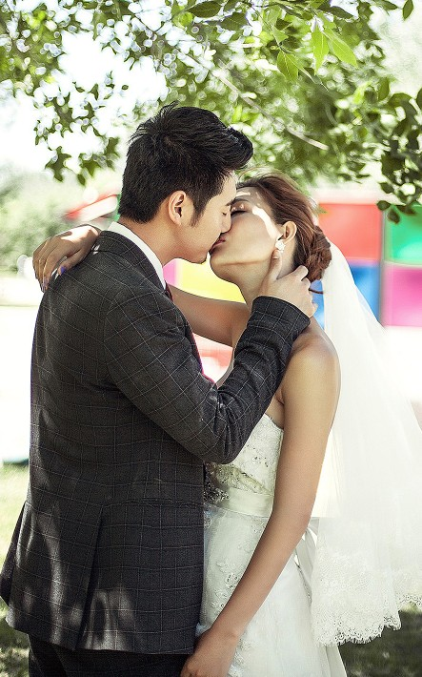

只属于你我的浪漫
Belongs only to you my romance

Slide 12
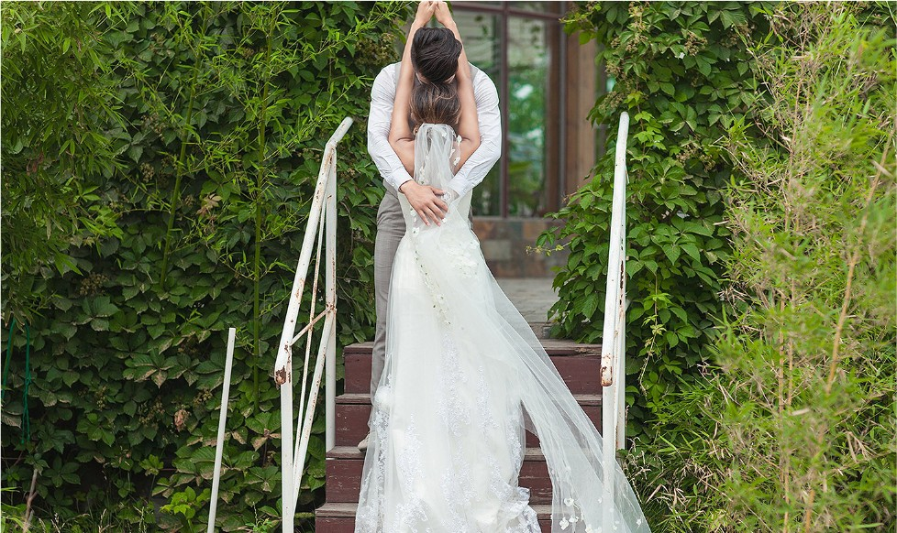
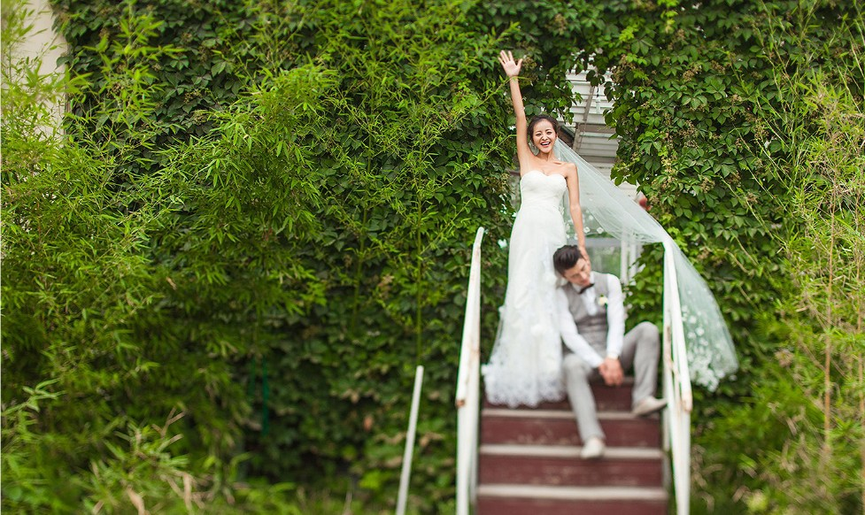
只属于你我的浪漫
Belongs only to you my romance

Slide 13


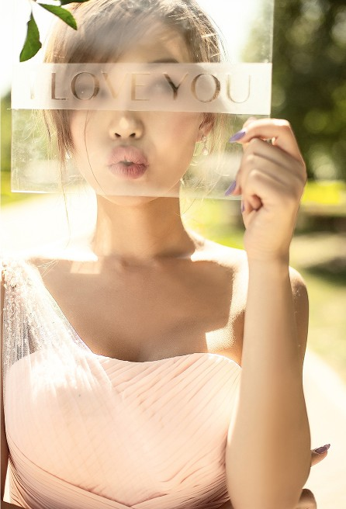
Belongs only to you my romance
只属于你我的浪漫

Slide 14
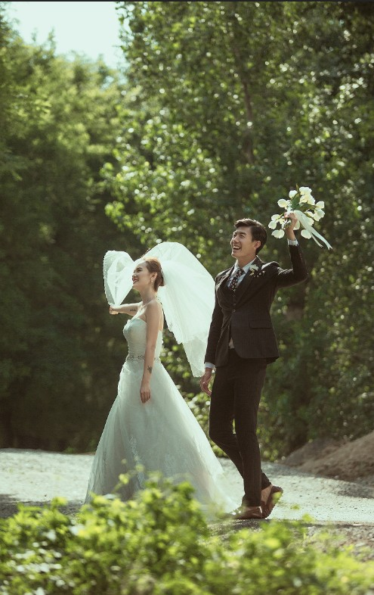


只属于你我的浪漫
Belongs only to you my romance

Slide 15
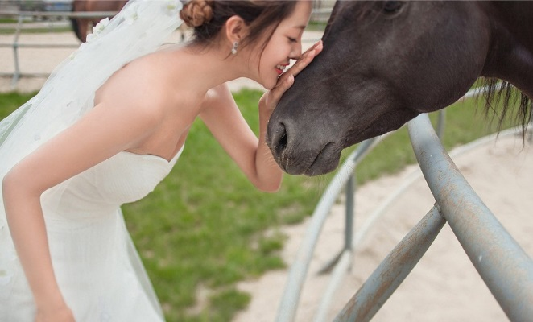
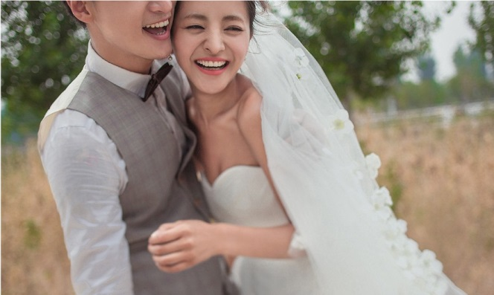
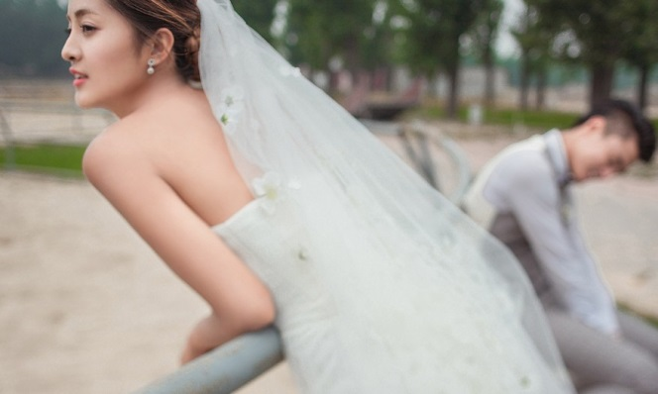
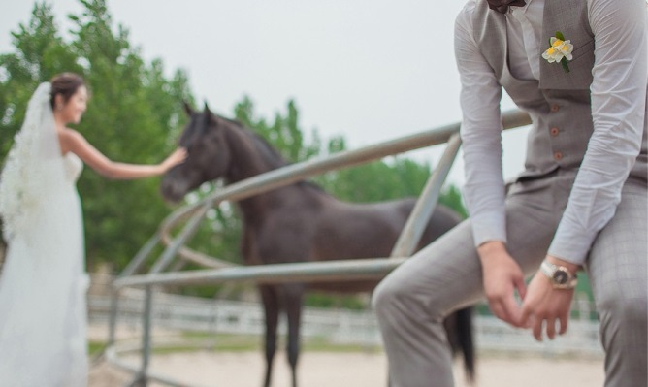
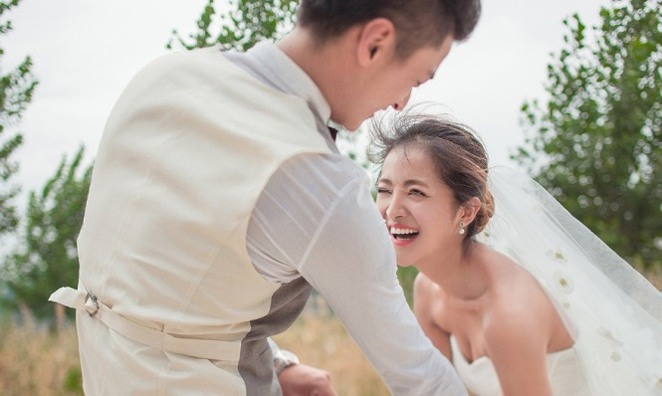
只属于你我的浪漫
Belongs only to you my romance

Slide 16
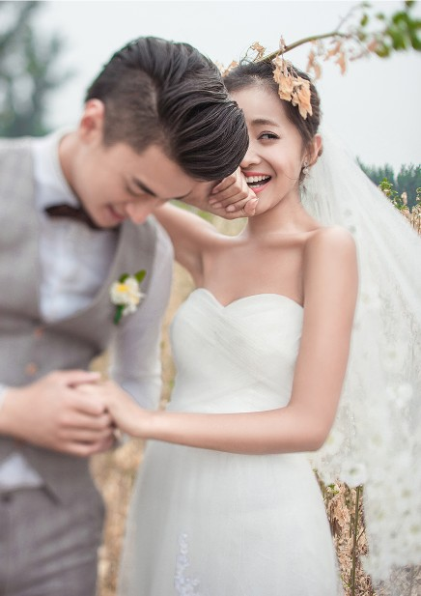

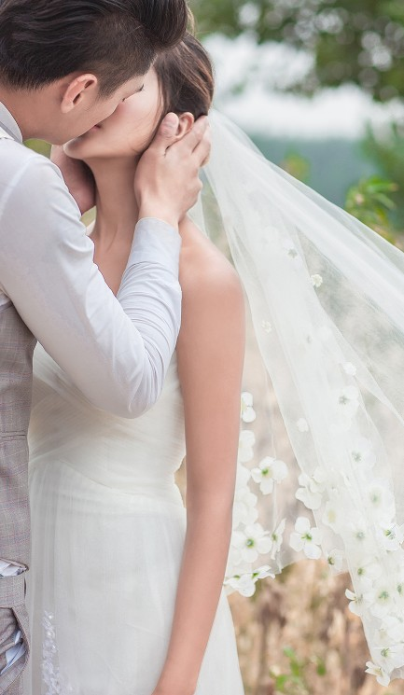
Belongs only to you my romance
只属于你我的浪漫

Slide 17
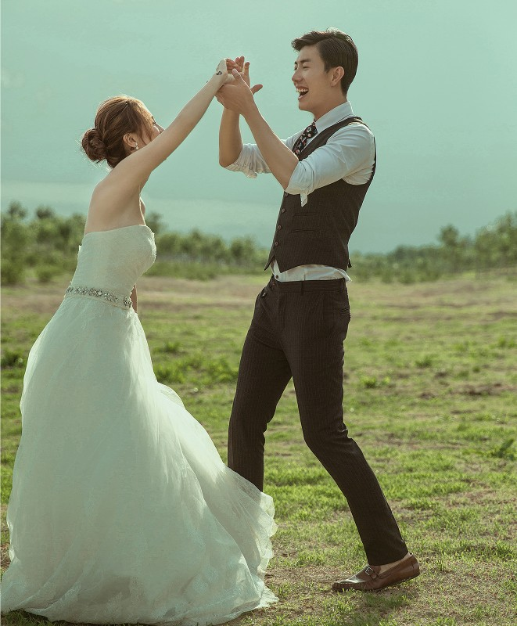

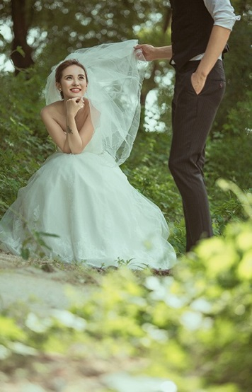

只属于你我的浪漫
Belongs only to you my romance

Slide 18
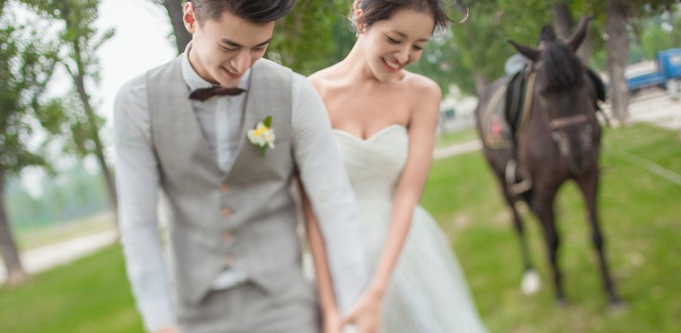
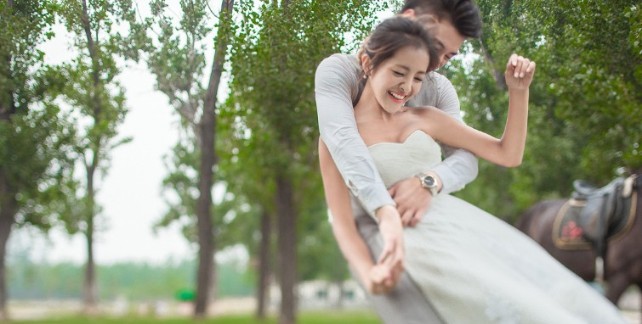
只属于你我的浪漫
Belongs only to you my romance

Slide 19


只属于你我的浪漫
Belongs only to you my romance

